Slide 1




NEXT GEN EMPLOYABILITY PROGRAM
Creating a future-ready workforce
Team Members
College Name
Student Name :Harina JM
Student ID :au110321104012
GRT INSTITUTE OF ENGINEERING AND TECHNOLOGY

Slide 2

CAPSTONE PROJECT SHOWCASE
Project Title
Web Application using Django Framework
Abstract | Problem Statement | Project Overview | Proposed Solution | Technology Used | Modelling & Results | Conclusion

Slide 3
Abstract
In today's digital age, music consumption has evolved drastically, with users seeking convenient and personalized platforms to discover, stream, and organize their favorite tunes. To cater to this demand, a Music Web Application utilizing the Django Framework presents a robust solution. Django, a high-level Python web framework, empowers developers to create scalable and feature-rich applications with ease. This Music Web Application aims to provide users with an immersive musical experience by incorporating functionalities such as user authentication, song browsing, playlist creation, recommendation systems, and social sharing capabilities.
Source :Books and Internet

Slide 4
Problem Statement
In the rapidly evolving landscape of digital music consumption, there exists a need for a comprehensive Music Web Application that caters to the diverse preferences and requirements of users. This application aims to address several key challenges faced by music enthusiasts, including fragmented music libraries, limited discovery options, and lack of personalized recommendations. The primary objective is to develop a robust and user-friendly platform that revolutionizes the way users discover, stream, and interact with music online.
Source :Books and Internet

Slide 5
Project Overview
This project aims to set a new standard for music web applications by providing a comprehensive platform that addresses the challenges of fragmented music libraries, limited discovery options, and lack of personalization. With its advanced algorithms, personalized recommendations, social integration features, and seamless user experience, Music web application offers music enthusiasts a revolutionary platform for discovering, streaming, and interacting with music online. Whether users are looking to explore new genres, discover emerging artists, or connect with friends over shared musical interests, This music web application promises to deliver an immersive and enjoyable music listening experience.
Source :Books and Internet

Slide 6
Proposed Solution
To address these challenges, we propose the development of a Music Web Application using the Django Framework, leveraging its robust features for rapid development and scalability. The application will offer the following key functionalities:
Centralized Music Library: Users can consolidate their music libraries from various sources, including local files and online streaming services, into a unified platform. The application will support seamless synchronization across devices, ensuring access to the entire music collection anytime, anywhere.
Advanced Discovery Algorithms: Utilizing machine learning algorithms and collaborative filtering techniques, the application will offer personalized music recommendations based on users' listening history, preferences, and social interactions. Advanced discovery options such as mood-based playlists, genre exploration, and artist recommendations will enhance the music discovery experience.
Personalized User Profiles: Each user will have a personalized profile that tracks their listening habits, favorite artists, and playlists. The application will use this data to generate tailored recommendations and curated playlists, ensuring a highly personalized music experience.
Social Integration: The application will incorporate social features such as user profiles, friend connections, and playlist sharing. Users can follow friends, discover music based on their social network's preferences, and collaborate on collaborative playlists, fostering a vibrant music community.
Source :Books and Internet

Slide 7
Key Features:
User Authentication and Profile Management:
MusicHub includes secure user authentication functionality powered by Django's built-in authentication system.
Users can register, log in, and manage their profiles, including profile customization and password management.
Unified Music Library Management:
Music Hub allows users to aggregate their music collections from various sources, including local files and external streaming services.
The application provides a centralized hub for managing and organizing music libraries, allowing users to browse, search, and categorize their favorite songs and albums.
Personalized Music Recommendations:
Leveraging Django's backend capabilities, MusicHub employs advanced algorithms to generate personalized music recommendations based on users' listening habits, preferences, and favorite genres.
Users receive tailored recommendations for songs, albums, playlists, and artists, enhancing their music discovery experience.
Source :

Slide 8
Dynamic Playlist Creation and Management:
MusicHub enables users to create, customize, and manage playlists based on their mood, genre preferences, or specific occasions.
Users can add, remove, and rearrange songs within playlists, as well as collaborate with friends on shared playlists.
Social Interaction and Sharing:
Music Hub fosters social interaction among users through features such as user profiles, friend connections, and playlist sharing.
Users can follow friends, discover music based on their social network's preferences, and share their favorite songs and playlists with others.
Responsive User Interface Design:
MusicHub adopts responsive design principles to ensure optimal user experience across devices, including desktops, tablets, and mobile phones.
The application's user interface is designed with usability and accessibility in mind, featuring intuitive navigation and interactive elements.
Source :

Slide 9


Technology Used
Front-end
Back-end
Source :

Slide 10
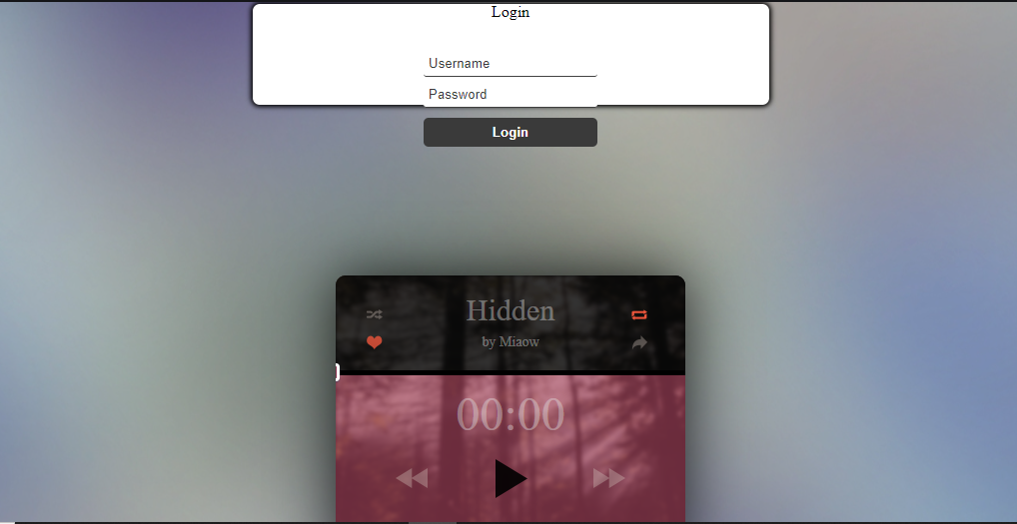
Modelling & Results
Source :Coding playground@ccbp.in

Slide 11
Homepage
In this music web application using Django framework the homepage will being created to enter the valid details username and password
Setting Up Django Project:
Install Django if you haven't already.
Create a new Django project using django-admin startproject projectname.
Create a new Django app within your project using python manage.py startapp appname.
Define Models:
Determine what data you need to represent on your homepage. For example, you might have models for artists, albums, songs, etc.
Define these models in your Django app's models.py file.
Run python manage.py makemigrations followed by python manage.py migrate to create database tables for your models.

Slide 12
About-Us-Page
Create Views:
Define views that will render your homepage.
Views typically fetch data from the database using Django ORM and pass it to a template for rendering.
You might have views for displaying featured artists, latest albums, trending songs, etc.
Create Templates:
Design HTML templates for your homepage and other pages.
Use Django's template language to dynamically generate content based on data passed from views.
Consider using CSS frameworks like Bootstrap for styling.
URL Routing:
Define URL patterns in your Django project's urls.py file to map URLs to views.
Decide on the URL structure for your homepage and other pages.

Slide 13
Service-Page
Define Services:
Determine what services or features you want to highlight on your service page. This could include features such as music streaming, personalized playlists, artist discovery, etc.
Define these services and their functionalities.
In addition to these steps, you may want to consider incorporating interactive elements into your service page, such as forms for users to sign up for premium services, interactive demos, or video demonstrations of your services in action. As with any page on your website, it's essential to maintain consistency in design and functionality and ensure that the service page aligns with the overall user experience and branding of your music web application.

Slide 14
Departments-Page
Define Departments:
Determine what departments or categories you want to showcase on your department page. These could include genres (rock, pop, jazz, etc.), music instruments, music production services, or any other categorization relevant to your application.
Define these departments and their characteristics.
Consider adding filtering or search functionalities to your department page to help users navigate through different departments efficiently. Additionally, you may want to incorporate features such as sorting options, related departments, or personalized recommendations to enhance user experience further. As with any page on your website, maintain consistency in design and functionality and ensure that the department page aligns with the overall user experience and branding of your music web application.

Slide 15
Blog-Page
Static Files:
Store static files like CSS, JavaScript, and images in the appropriate directories within your Django project.
Configure Django to serve these static files in development and collect them for production.
Testing:
Test your homepage and other features thoroughly to ensure they work as expected.
Use Django's testing framework to write automated tests for your views and other components.
Deployment:
Deploy your Django project to a production server using platforms like Heroku, AWS, or DigitalOcean.
Set up a database server for your Django project in production.
Configure web server settings and domain name settings as necessary.

Slide 16
Future Enhancements:
Advanced Recommendation System
Enhanced Social Features
Integration with music API’s
Live Streaming and concert listing
Music Visualization and Lyrics Integration
Podcast and Ausio content support
Voice Assistant Integration
Music collaboration tools
Localized Content and Internationalization
Accessibility and Inclusivity

Slide 17
Conclusion
In conclusion, MusicHub represents a comprehensive and innovative solution for music enthusiasts seeking a personalized and immersive music streaming experience. Built on the robust Django framework and integrated with frontend technologies, MusicHub offers a feature-rich platform that caters to diverse preferences and requirements.
Throughout the development of MusicHub, we have prioritized user experience, security, and scalability to ensure a seamless and enjoyable music discovery journey. From secure user authentication to personalized music recommendations and social interaction features, MusicHub offers a holistic approach to music streaming and discovery.
Furthermore, MusicHub's future enhancements, including advanced recommendation systems, enhanced social features, and integration with external music services, demonstrate our commitment to continuous improvement and innovation. By embracing emerging technologies and listening to user feedback, MusicHub aims to remain at the forefront of the music streaming industry.
Ultimately, MusicHub's success lies in its ability to connect users with their favorite tunes, foster community engagement, and provide an unparalleled music listening experience. As we continue to evolve and expand MusicHub's features and capabilities, we look forward to empowering music enthusiasts worldwide to discover, stream, and interact with music in new and exciting ways.
Source :Books and Internet

Slide 18
Thank You!
Notes:
Thank You !!

